Slide 1
AI Chatbot Workshop
Presented for San Diego Mesa College CS Club

Slide 2
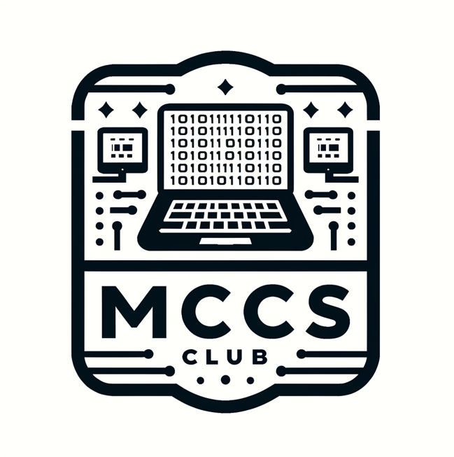


Aaron Cayanan
Prev AI Consultant @ Scale AI
MCCS Club Treasurer

Slide 3
Agenda

Slide 4
Introduction to ChatGPT API
Building a chatbot with Python
Improving Design with Figma
Final version using React and Flask

Slide 5
ChatGPT
ooooooh ahhhhhhhh

Slide 6

What is ChatGPT?
Developed by OpenAI based on the Generative Pre-trained Transformer (GPT) architecture.
Type of neural network design optimized for understanding and generating human language.
Trained on massive amounts of text data from the internet.
Goal:
Understand prompts and produce coherent, context-aware, and meaningful outputs.

Slide 7
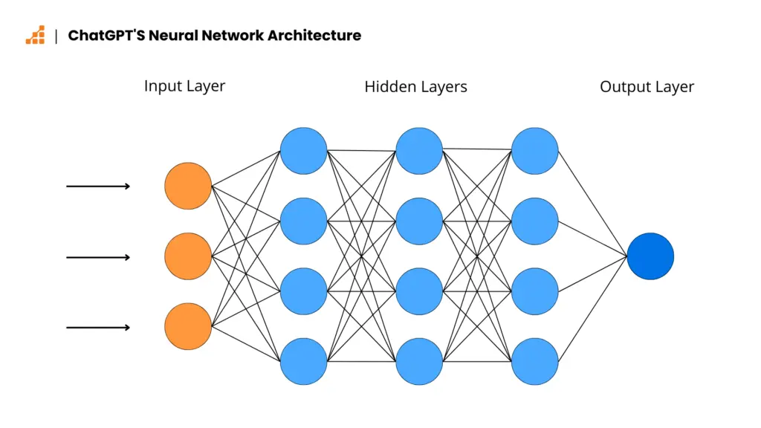
How Does ChatGPT Work?
Trains on huge datasets.
Learns patterns, language structures, and associations.

Slide 8
Why is ChatGPT Useful for Chatbots?
Natural Conversation Simulation
Context-Aware Responses
Scalable and Easily Deployable

Slide 9
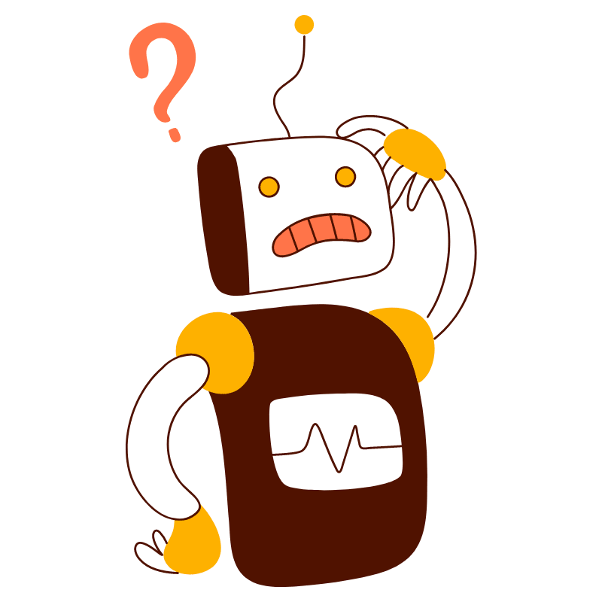
What is a Chatbot?
Designed to simulate conversations with humans.
Types of Chatbots
Rule-based Chatbots
AI-Powered Chatbots
User Input
Processing
Response Generation
Output

Slide 10
Common Use Cases

Slide 11
Common Use Cases
Customer Support
E-commerce
Healthcare
Education
Entertainment

Slide 12
What is an API?
Definition: Application Programming Interface is a set of rules that allows two applications to communicate with each other. Acts as a bridge between systems or software.

Slide 13
think of it this way…

Slide 14
How to Access the ChatGPT API

Slide 15
Tkinter
woah so cool so magical

Slide 16
What is Tkinter?
Python’s standard GUI (Graphical User Interface) library
It provides tools to create desktop applications with windows, buttons, labels, and more.

Slide 17
building time.

